Slide 1
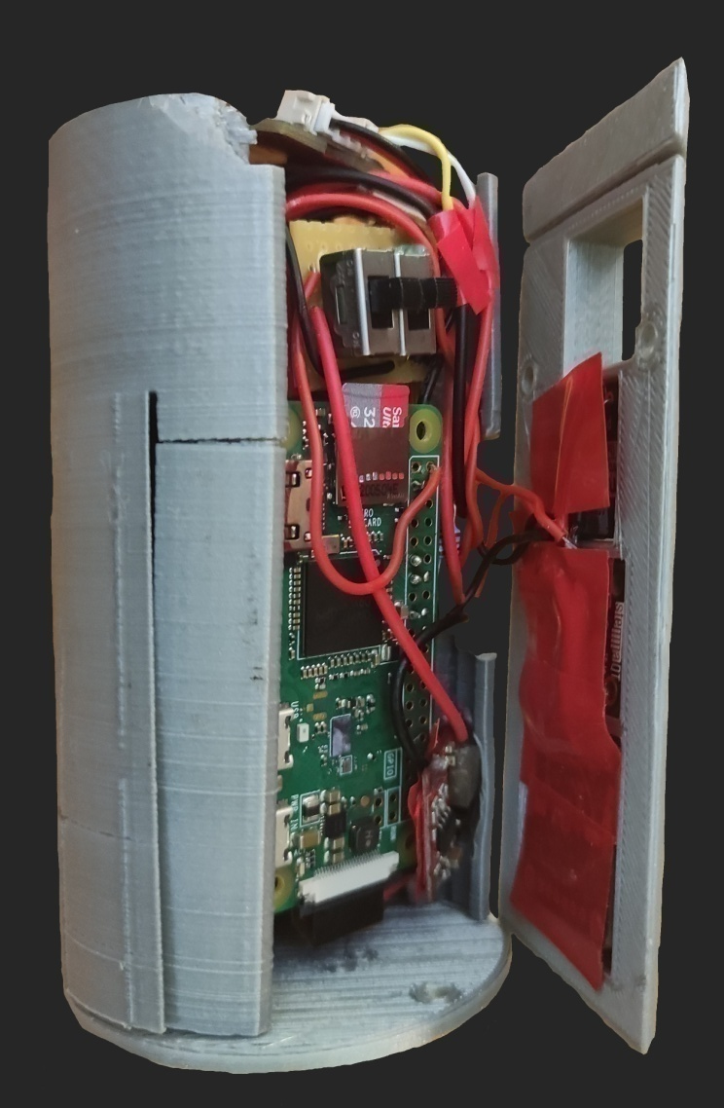
LC-SAT
EUROPEAN FINAL
→ THE EUROPEAN SPACE AGENCY

Slide 2
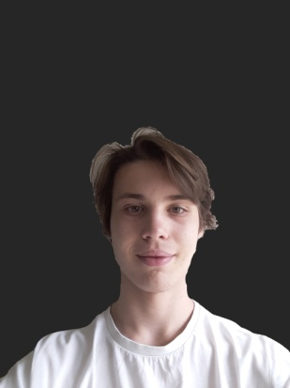
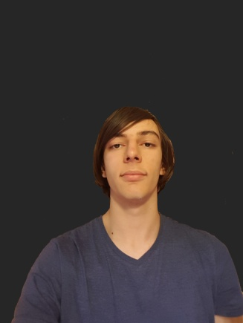
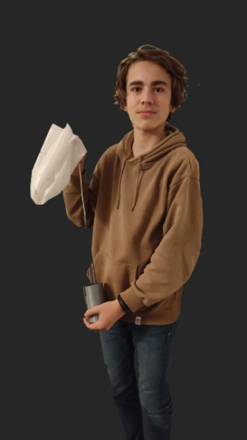
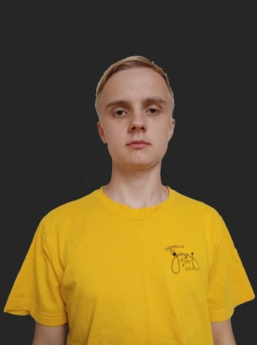
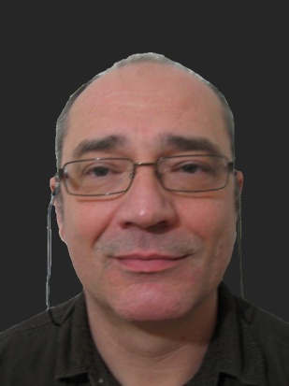
Our team
Jiří
2 / 20
HODSON
Thomas
18
URLI
Aristide
18
GEBAUER
Jiří
18
DROUYNOT
Titouan
15
DE CLERCQ
Bernard
→ THE EUROPEAN SPACE AGENCY

Slide 3
Mission outines
Thomas
3 / 20
Record data
Process data
→ THE EUROPEAN SPACE AGENCY

Slide 4
Mission outines
Thomas
Purpose
4 / 20
Find correlations between
different parameters.
→ THE EUROPEAN SPACE AGENCY

Slide 5
Team and Project management
Jiří
5 / 20
Weekly meetings to answer
the “what” questions.
The “how” questions were answered
By the member in charge.
Project
Management
Team
Management
Workload spitted between the
members depending on their
roles and their motivation.
→ THE EUROPEAN SPACE AGENCY

Slide 6
Outreach program
Jiří
6 / 20
Social media
to promote
the project.
Especially a
young public.
Media to
Carry the
project.
→ THE EUROPEAN SPACE AGENCY

Slide 7
Outreach program
Jiří
We created our own website.
https://lc-sat.tk
7 / 20
We appeared in our high school article and
in the MJC of Chenôve articles.
The newspaper “Le Monde des Ados”
is writing an article.
We ask local radios but no responses.
→ THE EUROPEAN SPACE AGENCY

Slide 8
External support
Jiří
8 / 20
Our high school
AMCCO:
Parachute test
GJN Aerospace:
Parachute formulas
Burgundy University
(Mathieu Rosse):
Electrical test
→ THE EUROPEAN SPACE AGENCY

Slide 9
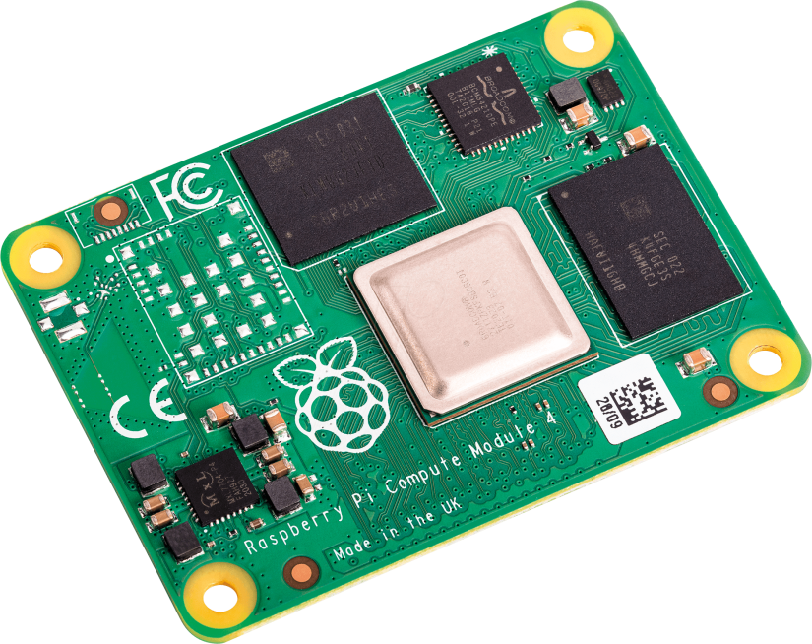
Hardware
Titouan
9 / 20
Needs a
Custom PCB
Small
Powerful
Integrated WIFI
Supports cameras
Raspberry Pi
Compute Module 4
→ THE EUROPEAN SPACE AGENCY

Slide 10
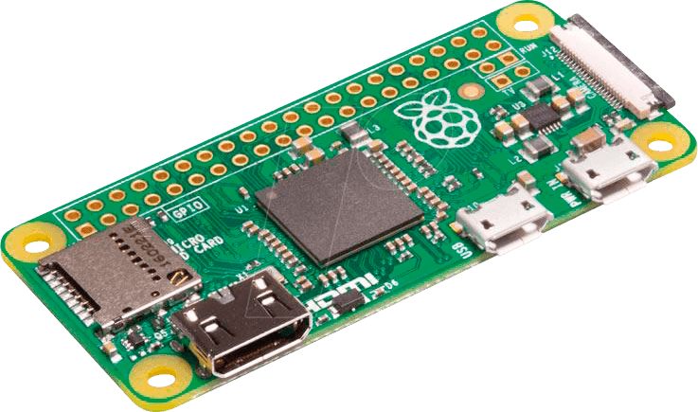
Hardware
Titouan
10 / 20
Less powerful
Same advantages
as the CM4.
Simpler to use.
Doesn’t need
a PCB
Energy efficient
Raspberry Pi
Zero W
→ THE EUROPEAN SPACE AGENCY

Slide 11
Electrical design
Titouan
11 / 20
I²C Protocol
Allows components to communicate directly.
→ THE EUROPEAN SPACE AGENCY

Slide 12
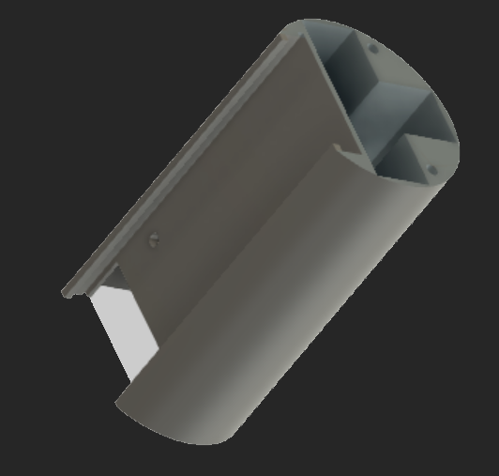
Structure
Titouan
12 / 20
Printed
with
Bio-plastic
Designed
with
KidCat
→ THE EUROPEAN SPACE AGENCY

Slide 13
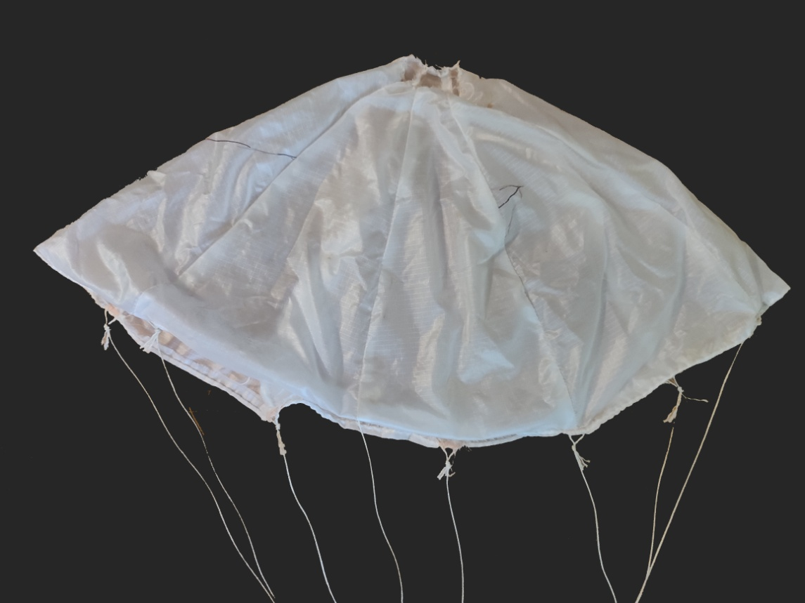
Parachute
Titouan
13 / 20
Formulas
provided
by GJN
Aerospace
→ THE EUROPEAN SPACE AGENCY

Slide 14
Software
Thomas
Internal software to communicate commands to sensors.
14 / 20
External software for data processing.
→ THE EUROPEAN SPACE AGENCY

Slide 15
External software
Thomas
15 / 20
Computer
External
Software
Online
External
Software
→ THE EUROPEAN SPACE AGENCY

Slide 16
External software
Thomas
16 / 20
Computer
External
Software
Professional software for scientists,
engineers, corporations, etc…
Online
External
Software
Online open source software for
students, teachers, amateur projects,
etc…
→ THE EUROPEAN SPACE AGENCY

Slide 17
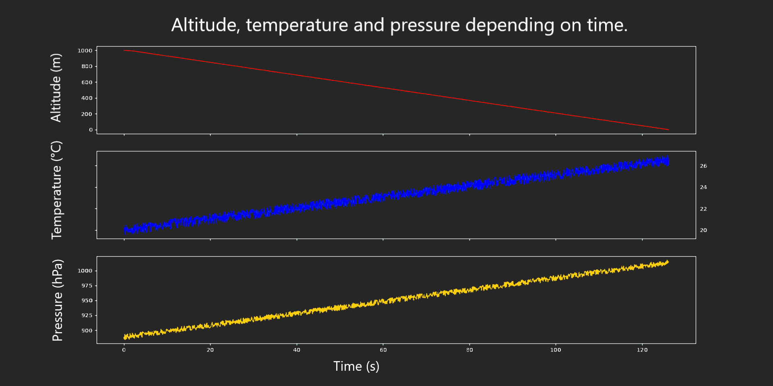
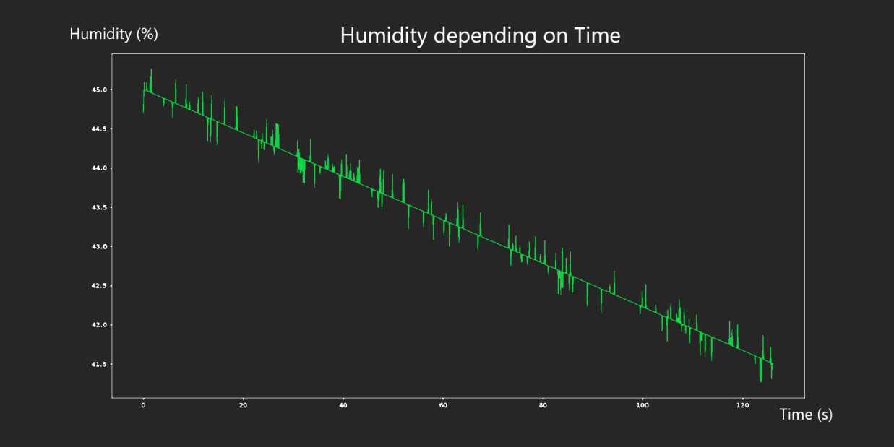
Modelled results
Thomas
Altitude, temperature and pressure dependign on time.
17 / 20
Correlation between the temperature
the pressure, the humidity rate and
the altitude.
→ THE EUROPEAN SPACE AGENCY

Slide 18
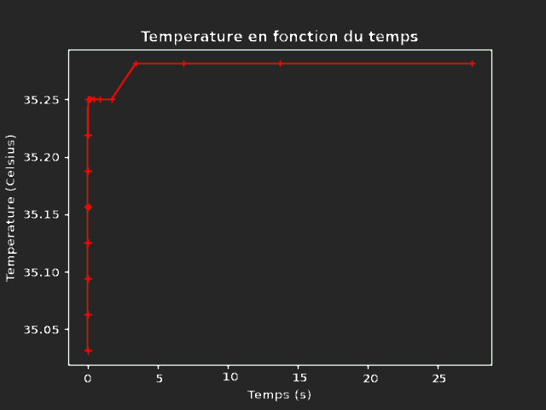
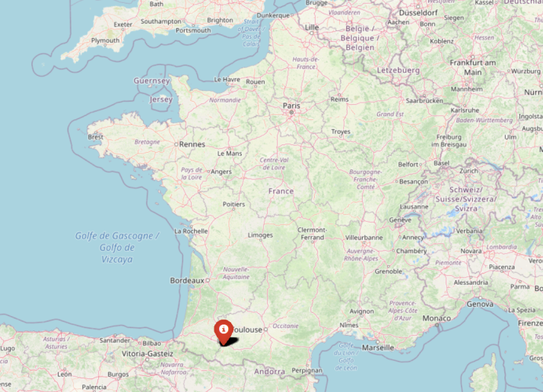
Real results
Thomas
Our CanSat didn’t record the ascent, the drop and the descent
due to the Covid-19 situation and an unexpected software action.
18 / 20
Temperature
recorded
Recorded on
the ground
Position
recorded
→ THE EUROPEAN SPACE AGENCY

Slide 19
Conclusion
Titouan
Requirements
Characteristic | Requirement |  | Value | Eligibility
Height | ≤ 115 mm |  | 114mm | Yes
Diameter | ≤ 66 mm |  | 64 mm
Mass | 300 – 350 g |  | ≈ 340 g
Flight time scheduled | ≤ 170 s |  | 120 – 130 s
Additional length of external elements (along axial dimension) | None
Calculated descent rate | 5 – 12 m/s | 8 m/s
Autonomy | ≥ 4 h | 20 h 45 min
Total cost | ≤ 500 € | ≈ 250 €
19 / 20
More powerful onboard computer
A 3d modeling review.
After almost 1 year of hard work, we all consider our mission successful.
→ THE EUROPEAN SPACE AGENCY

Slide 20
20 / 20
Thank for your attention.
→ THE EUROPEAN SPACE AGENCY

Slide 21
Software review
21 / 20
Pre-built libraries
We used Python 3.9
Supported by RPI
Common language
Internal software:
time – smbus(2) – micropython - i2cdevice – struct – winsound - pickle – numpy - pyAesCrypt – io
os – tarfile – threading – argparse – RPi – flask – logging – adafruit_hts221 – board – busio – adafruit_gps Adafruit-Blinka - adafruit-circuitpython-gps - adafruit-circuitpython-hts221 -adafruit-circuitpython-register
Computer external software:
os – tkinter – json – shutil – zipfile – pyAesCrypt – matplotlib – numpy – folium – webbrowser – pickle
opencv (cv2)
Online external software:
os – sys – subprocess – datetime – numpy – json – zipfile – shutil – time – io – pickle – yaml – flask matplotlib – opencv (cv2) – folium – requests - math
→ THE EUROPEAN SPACE AGENCY

Slide 22
Software diagram
22 / 20
→ THE EUROPEAN SPACE AGENCY

Slide 23
Internal communications
23 / 20
→ THE EUROPEAN SPACE AGENCY

Slide 24
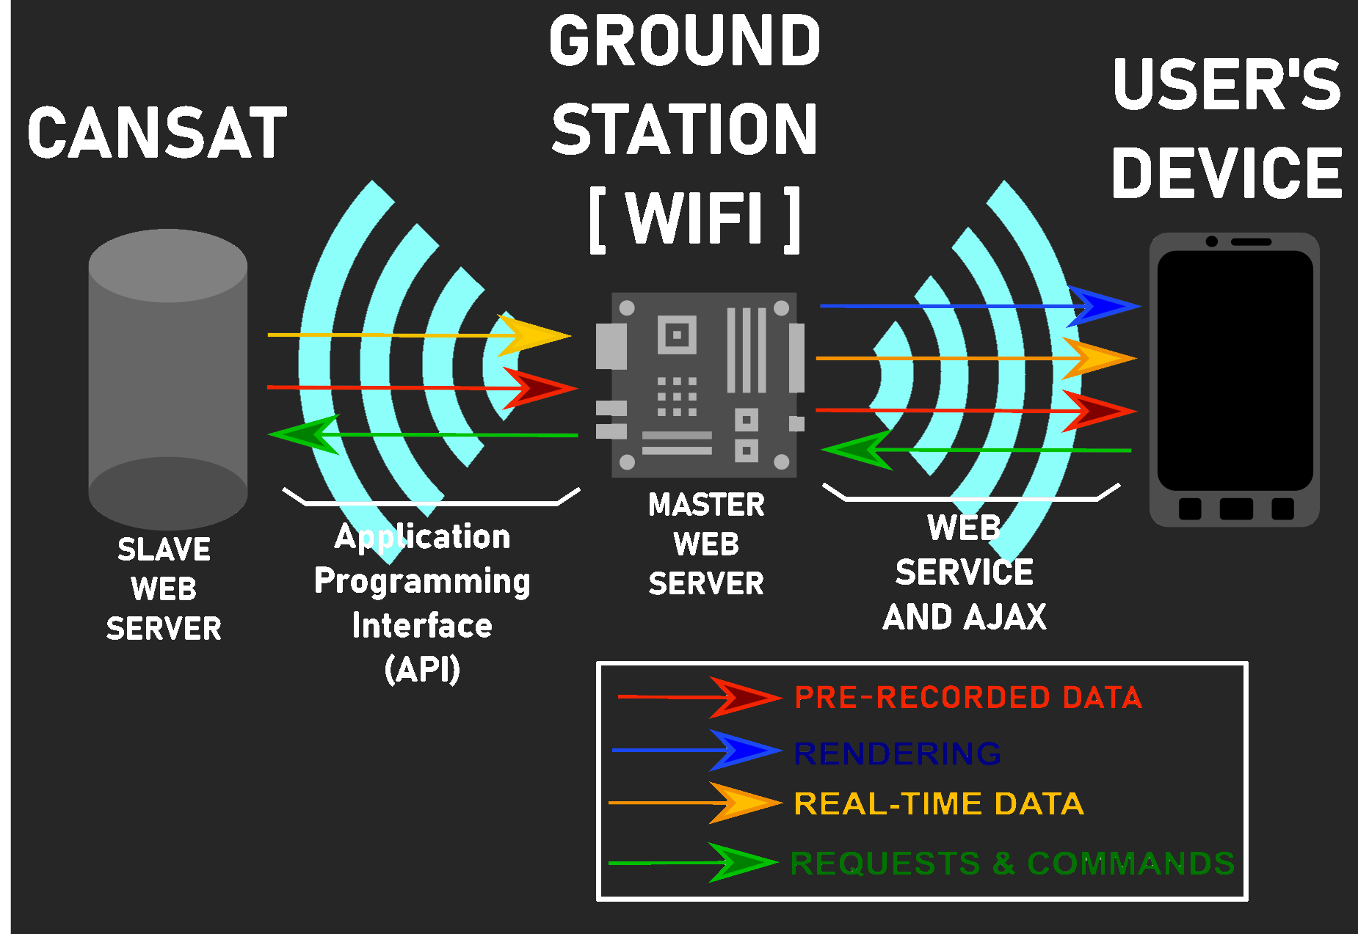
External communications
24 / 20
→ THE EUROPEAN SPACE AGENCY

Slide 25
Detailed outreach program
25 / 20
Realised
Name | Type | Actions | Public
Discord | Social media | Create and communicate with a community. |  | Young public
Twitter
Instagram
YouTube | Video media | Upload video to present our project.
Our website | Website | We created articles to promote our project and explain how it works. |  | Old public
MJC CS Of Chenôve |  | A Cultural centre which post an article on Facebook and its website.
Github | Professional sharing platform | Upload our programs |  | Professional public
Carnot High School | Website | Posted an article on the high school’s website. |  | Our schoolmates
In process or no response.
Name | Type | Actions | Public
Okapi | Newspaper | No response | Young public
Le petit quotidien
Le monde des ados |  | In process
Le bien public |  | No response | Old public
Radio Uno | Radio
Radio campus
→ THE EUROPEAN SPACE AGENCY

Slide 26
Detailed external support
26 / 20
Successful
Name | Phase | Reason
Carnot High school | 1 and 2 | Economic support (500€) and outreach program.
AMCCO: a local Aero modelling club | 1 | Drop tests.
GJN Aerospace (previous team of Jiří Gebauer) |  | Helped with the Recovery system.
Burgundy University, especially Mr Matthieu Rossé (a teacher researcher in electronics). |  | Helped to solve a major problem with his experience and the university’s high-tech equipment.
Planète sciences | 1 and 2 | Answered our questions and helped us with the presentation.
Unsuccessful
Name | Actions |  |  | Reason
Bobby Duke Arts (An Art Youtuber). |  | No response | We wanted to decorate our CanSat. No response.
Hacksmith Industries (A YouTube engineering Team). |  |  | They usually undertake similar projects. We asked for advice. No response.
Robin Aircraft |  |  | Local aircraft manufacturing factory.
→ THE EUROPEAN SPACE AGENCY

Slide 27
Data amount
27/ 20
Amount of data recorded on each sensor
Sensor | Recording frequency | Amount recorded per minute
Primary camera | 720p 30fps, h264 format | 444 MB
Thermal camera | 8x8 pixels 10fps, uncompressed 16bits/pixel | 75 MB
Temperature, pressure and altitude sensors | 10 records per seconds (3x16 bits). | 3,51 KB
Accelerometer
GPS
Total amount of data recorded |  | 519 MB / minute
4 GB for the OS and for the programs.
→ THE EUROPEAN SPACE AGENCY

Slide 28
Energy consumption
28 / 20
Energy consumption in 1 hour:
Component | Tension (V) | Intensity (mAh) | Power (mWh)
Raspberry Pi Zero W | 5 | 170 | 850
BMP280 module | 3,3 | > 0,1 | > 0,1
GPS module |  | 28 | 92,4
Accelerometer module |  | > 0,1 | 0,3
HTS221 module |  | > 0,1 | > 0,1
Thermal camera |  | 4,5 | 14,9
Camera Pi NoIR V2 |  | 250 | 825
Buzzer |  | 16 | 52,8
DEL Indicator |  | 2 | 6,6
DEL Indicator
Total power |  |  | 1850
→ THE EUROPEAN SPACE AGENCY

Slide 29
Timeline
29 / 20
TABLE 3 - Latest project plan
Date | Task
Middle of November 2020 | Jiří Gebauer and Titouan Drouynot founded the team.
End of November 2020 | We were looking for the other members and sent our application.
Beginning of December 2020 | We contacted the French jury for the first time.
Middle of December 2020 | Development of two concepts started (Teensy and Raspberry Pi).
End of December 2020 | We decided to use the Raspberry Pies computers.
Middle of January 2021 | First attempts to gain sponsors.
End of January 2021 | Our school provided us with a 500€ budget.
Middle of February 2021 | Basis of our new concept are known.
Beginning of March 2021 | We ordered everything needed for our CM4 concept.
10.03.2021 | Successful tests of the parachute with ballast CanSat.
17.07.2021 | Official drop phase of the national competition.
→ THE EUROPEAN SPACE AGENCY

Slide 30
Roles
Design
30 / 20
Software
Hardware
3D modelling
Outreach
External
support
→ THE EUROPEAN SPACE AGENCY

Slide 31
Project budget
31 / 20
Cansat Price
Component | Unit price (€) | Quantity | CanSat price (€)
Buzzer | 0,59 | 1 | 0,59
16 GB micro SD card | 16,95 | 1 | 16,95
Thermal camera | 45,60 | 1 | 45,60
Accu Li-Ion MGL99015 | 13,90 | 4 | 55,60
BMP280 module | 9,50 | 1 | 9,50
GPS PA1010D module | 37,90 | 1 | 37,90
Infrared Camera | 29,90 | 1 | 29,90
Accelerometer module | 3,99 | 1 | 3,99
Humidity sensor | 8,50 | 1 | 8,50
5 Vcc regulator | 3,95 | 1 | 3,95
Slide switch | 3,17 | 2 | 6,34
DEL indicator | 0,43 | 1 | 0,43
Raspberry Pi Zero W | 10,00 | 1 | 10,00
DESON M3 insert | 0,18 | 5 | 0,90
JST standard inputs | 0,86 | 4 | 3,44
Plastic |  |  | About 1€
Parachute |  |  | About 6€
CanSat’s total price |  |  | ≈250 €
Project Price
Component | Unit price (€) | Quantity | Total price (€)
CanSat | 250 | 1 | 250
PCB | 4,67 | 1 | 4,67
Long connector | 0,70 | 1 | 0,70
Raspberry Pi 0 W | 10,00 | 2 | 20,00
Raspberry Pi CM4 | 54.00 | 1 | 54.00
DEL indicator | 0.43 | 1 | 0.43
Card connector | 0.89 | 1 | 0.89
FCP BOTTOM 15POS | 0.78 | 1 | 0.78
0.1UF capacitor | 0.31 | 7 | 2.17
10 UF capacitor | 0.39 | 1 | 0.39
PMIC – RT9742GGJ5 | 1.33 | 1 | 1.33
PMIC – RT9742CGJ5 | 0.70 | 1 | 0.70
CM4 connector | 1.43 | 2 | 2.86
715 OHM resistance | 0.21 | 2 | 0.42
10K OHM resistance | 0.30 | 10 | 3.00
1.6K OHM resistance | 0.21 | 2 | 0.42
12K OHM resistance |  | 1 | 0.21
Other |  |  | ≈ 5 €
Project total price |  |  | ≈350 €
→ THE EUROPEAN SPACE AGENCY

Slide 32
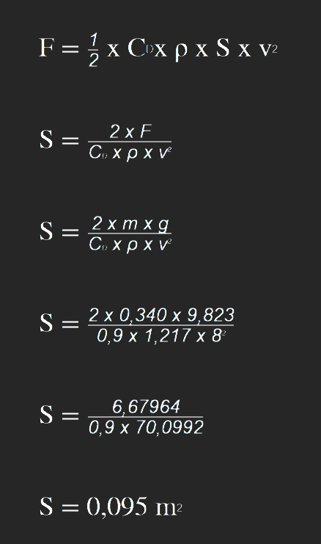
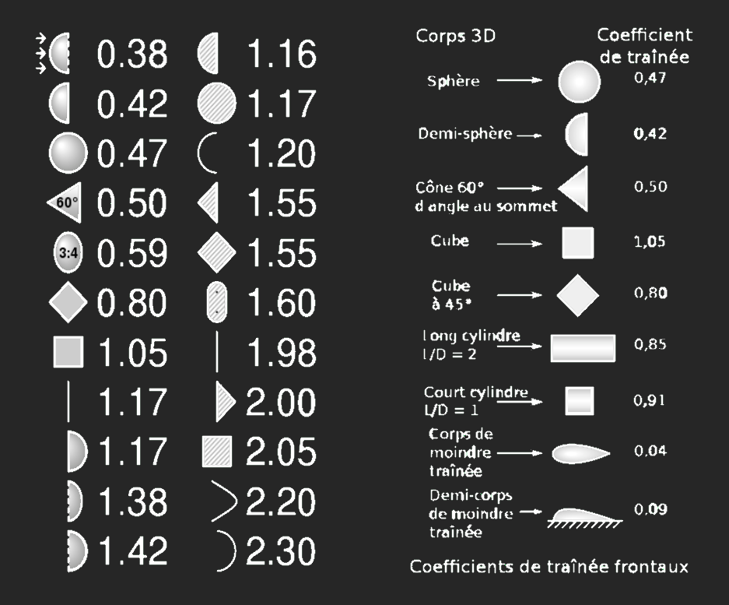
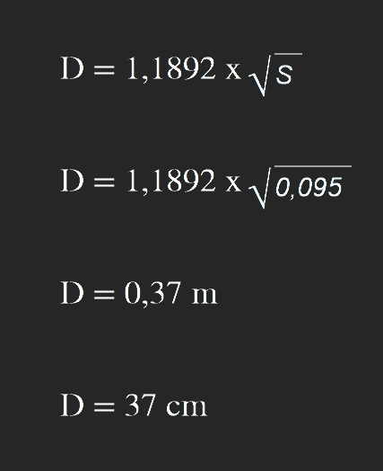
Recovery system
32 / 20
→ THE EUROPEAN SPACE AGENCY

Slide 33
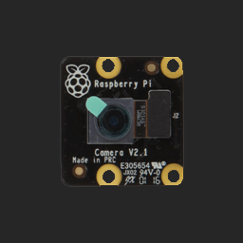
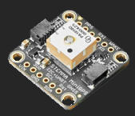
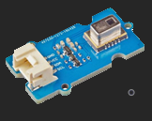
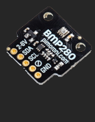
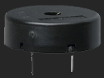
Components
33 / 20
Accelerometer
GPS
Infrared
camera
Humidity & temperature
Thermal
camera
Temperature
Pressure
Altitude
Buzzer
→ THE EUROPEAN SPACE AGENCY

Slide 34
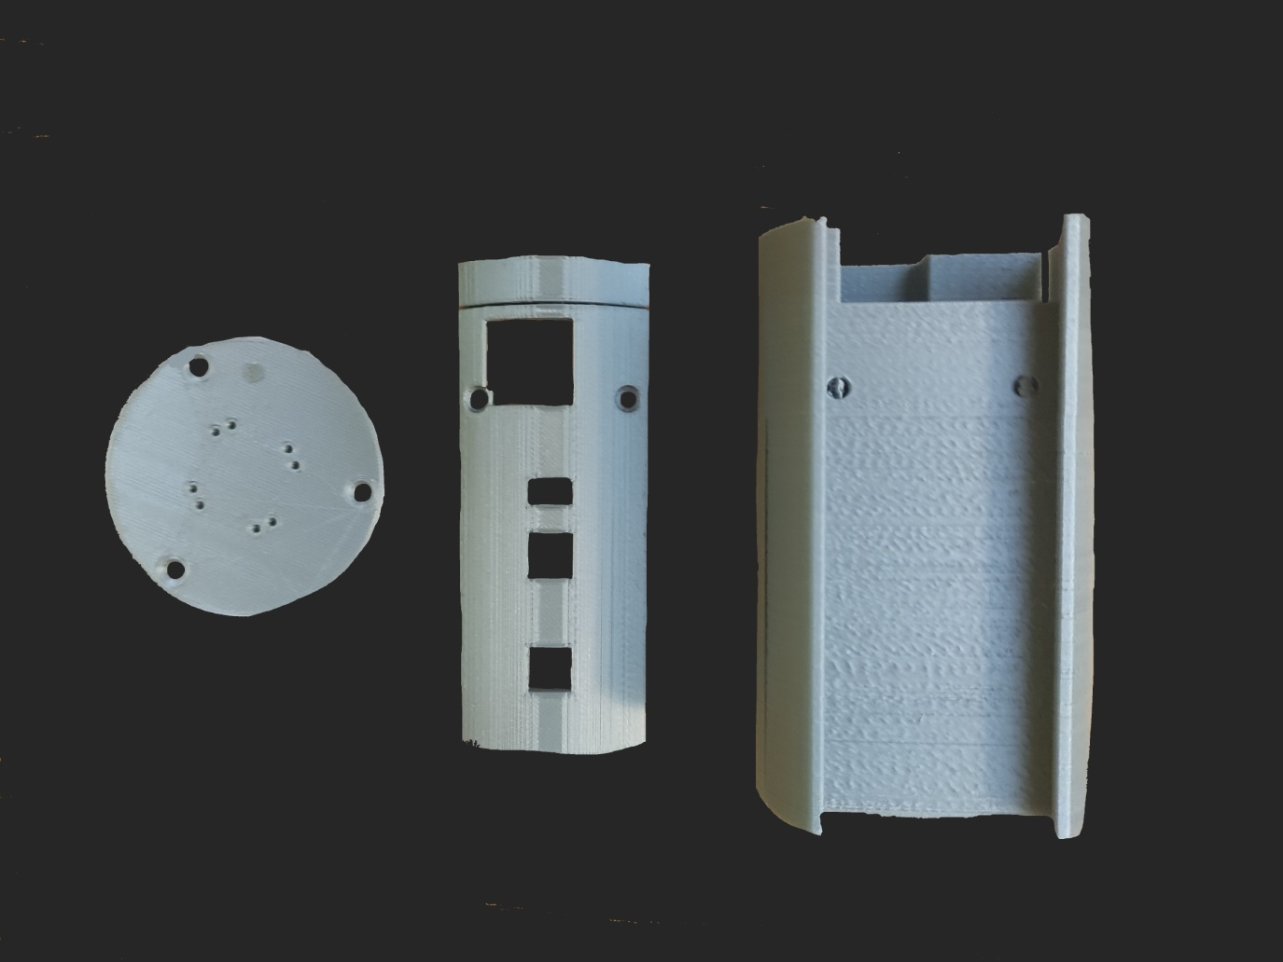
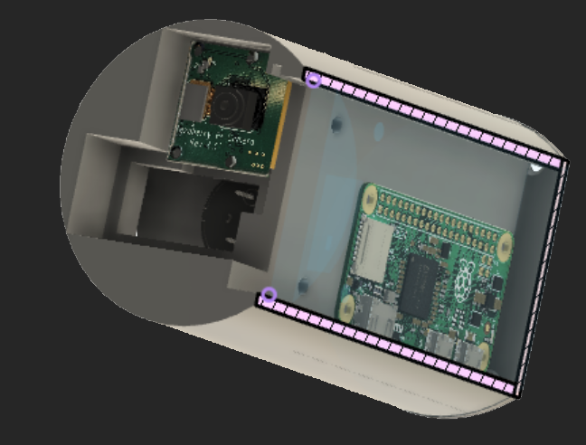
3D models
34 / 20
→ THE EUROPEAN SPACE AGENCY

Slide 35
Raspberry Pi CM4 Problem
35 / 20
➔ Only works in development.
Hardware tests (PCB review):
We went to Burgundy University, with Mathieu Rossé. We tested:
The power line (from the Batteries to the CanSat).
The electrical continuity (to test if the PCB was faulty).
Checked with a Binocular all the welds.
Cleaned the welds with dissolvent.
Presented the electrical design to Mathieu Rossé.
Software tests:
Unitary test.
Tested different programs.
→ THE EUROPEAN SPACE AGENCY

Slide 36
Team members
36 / 20
URLI Aristide
18 years old
Following the PREPA MP2I
Maths Physics and
Computer sciences
HODSON Thomas
18 years old
Following a double degree
Maths and Computer sciences
GEBAUER Jiří
18 years old
In 11th grade
Maths Physics Chemistry
Computer sciences
Drouynot Titouan
15 years old
In 11th grade
Maths Physics Chemistry
Biology
→ THE EUROPEAN SPACE AGENCY

Slide 37
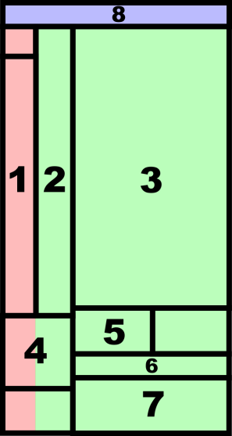
Components locations
37 / 20
Component locations
Component | Location in the Cansat
Pressure, temperature sensors (and altitude estimation) | 1
GPS
Humidity and temperature sensors.
Raspberry Pi Zero W | 2
Batteries | 3
Switches | 4
DEL indicators
Buzzer | 5
3 axes accelerometer | 6
Primary camera (records infrared signals) | 7
Thermal camera
Parachute fixations | 8
→ THE EUROPEAN SPACE AGENCY

Slide 38
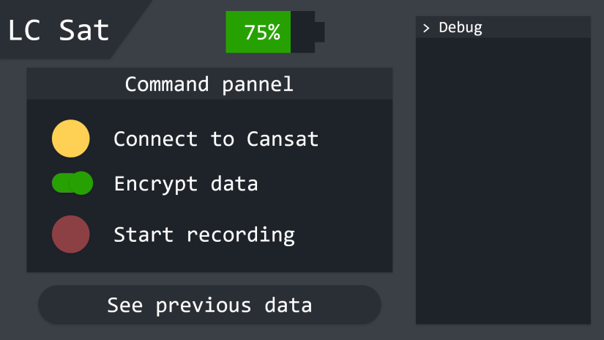
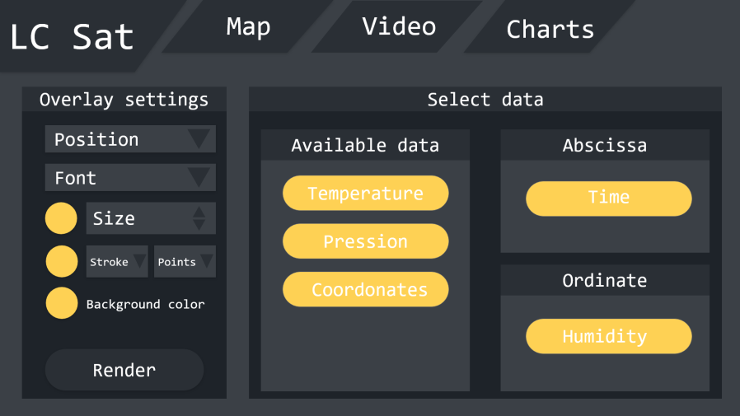
Design
38 / 20
Adobe XD
→ THE EUROPEAN SPACE AGENCY

Slide 39
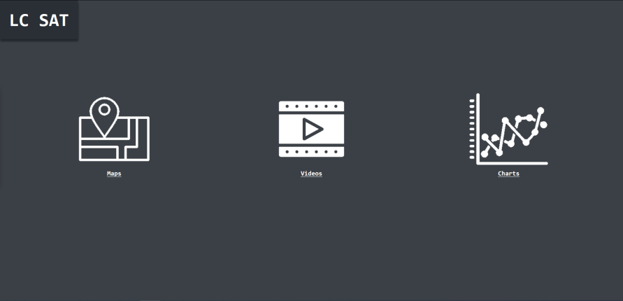
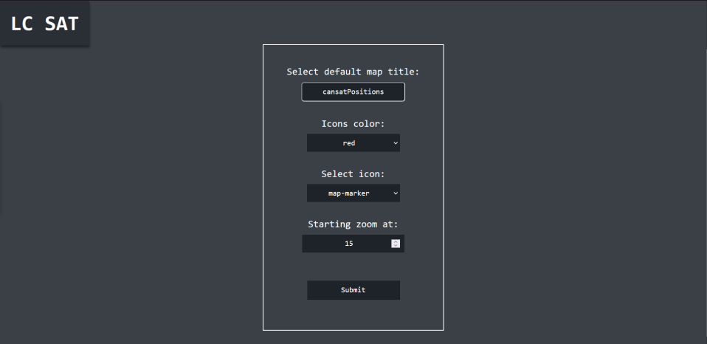
Online software screenshots
39 / 20
→ THE EUROPEAN SPACE AGENCY

Slide 40
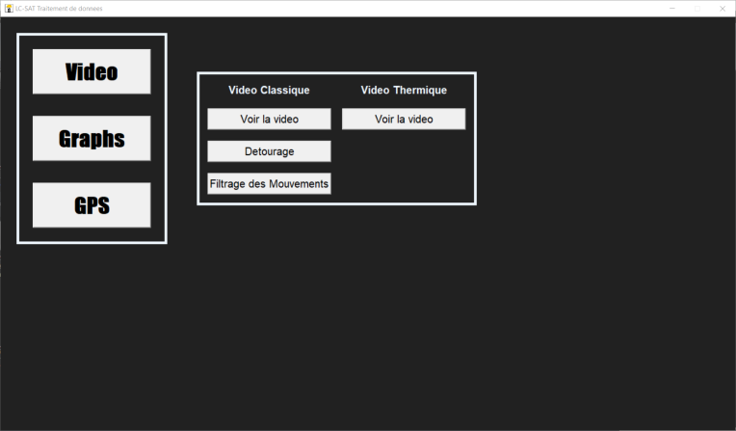
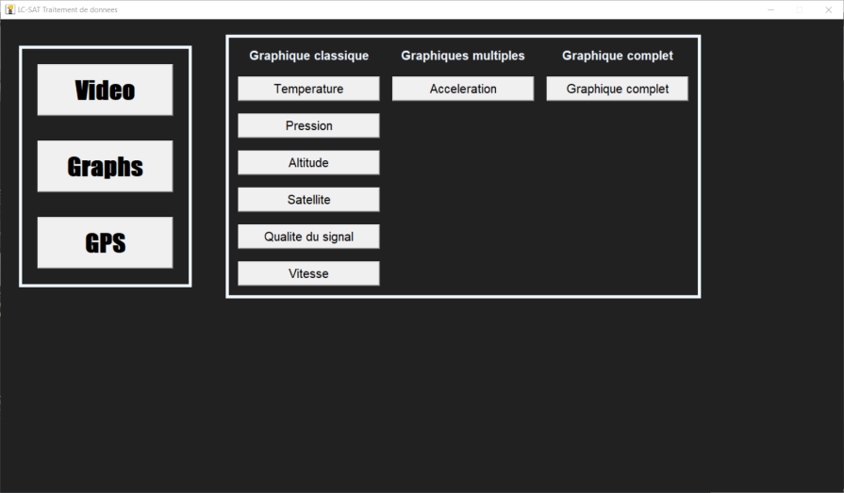
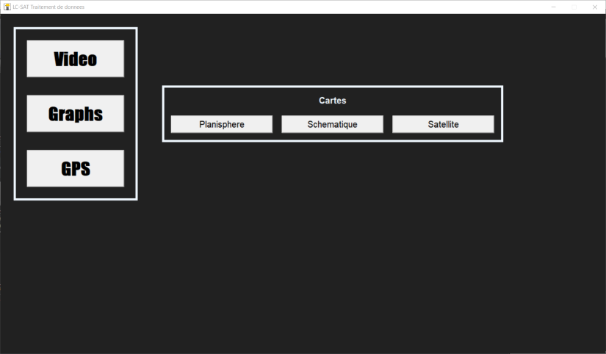
Computer software screenshots
40 / 20
→ THE EUROPEAN SPACE AGENCY

Slide 41
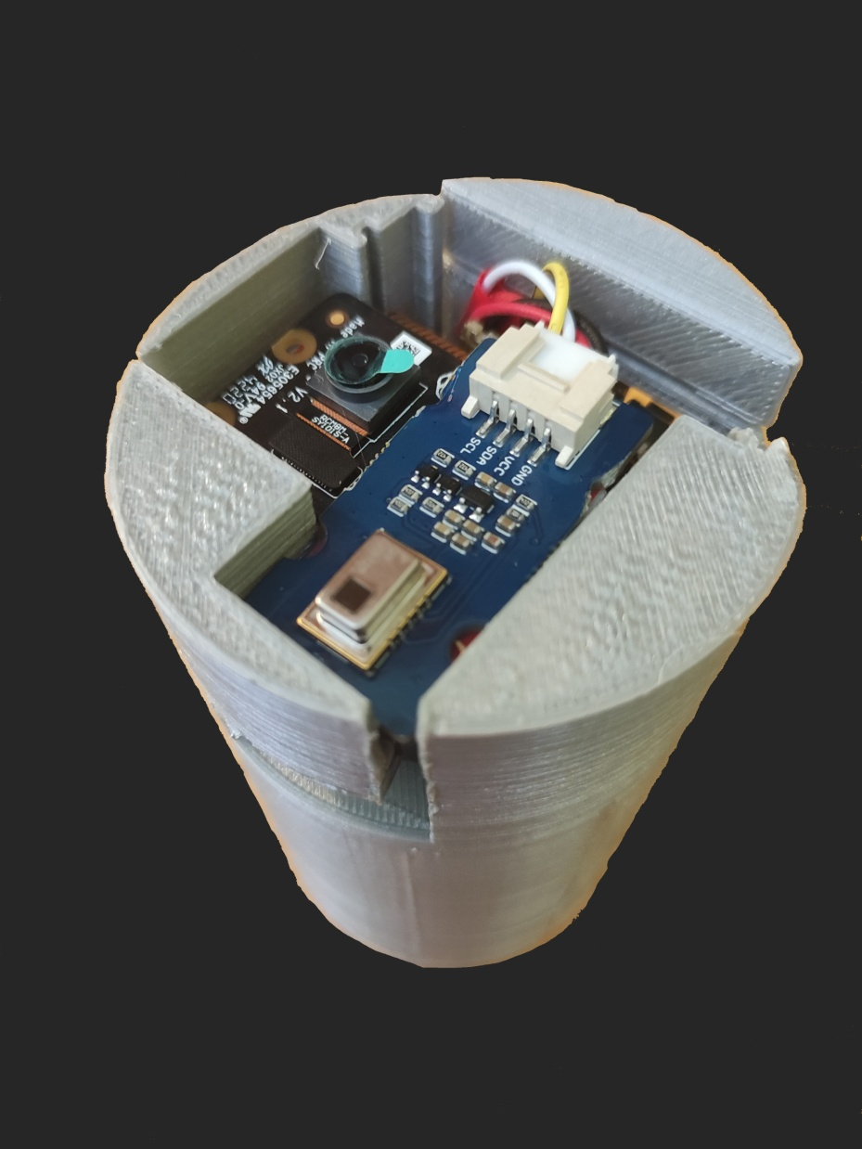
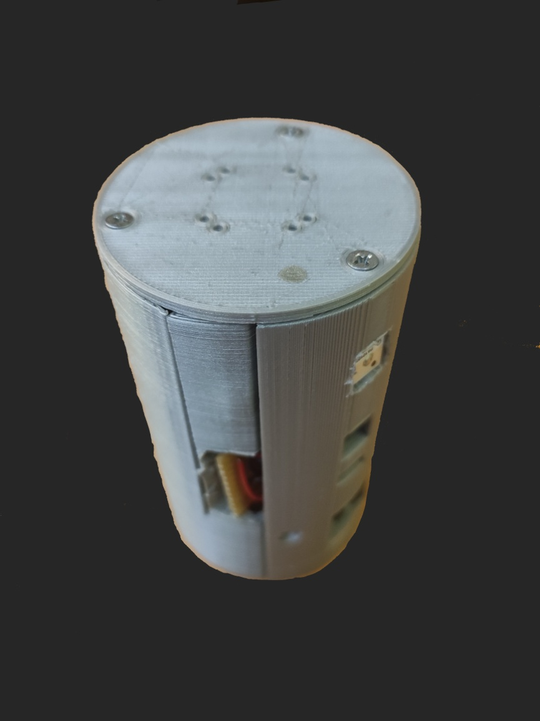
CanSat pictures
41 / 20
→ THE EUROPEAN SPACE AGENCY

Slide 42
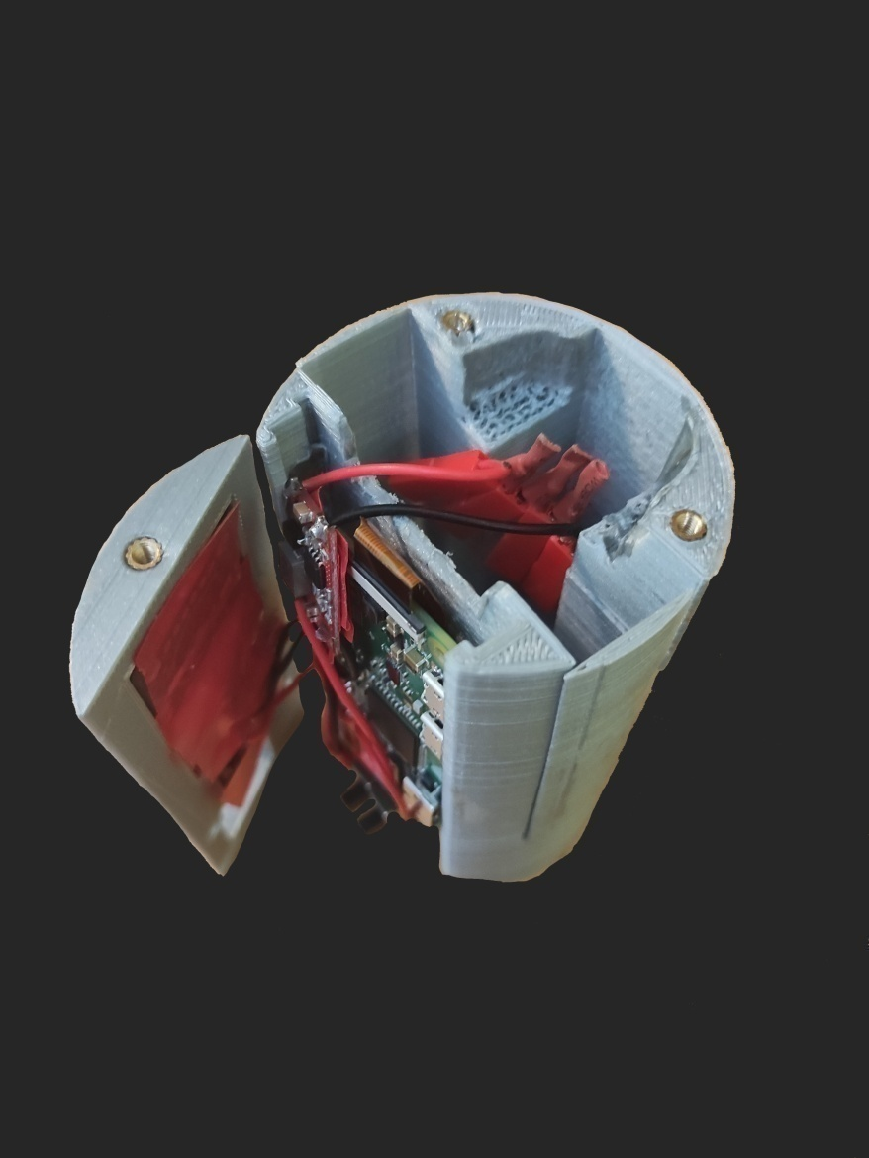
CanSat pictures
42 / 20
→ THE EUROPEAN SPACE AGENCY

Slide 43
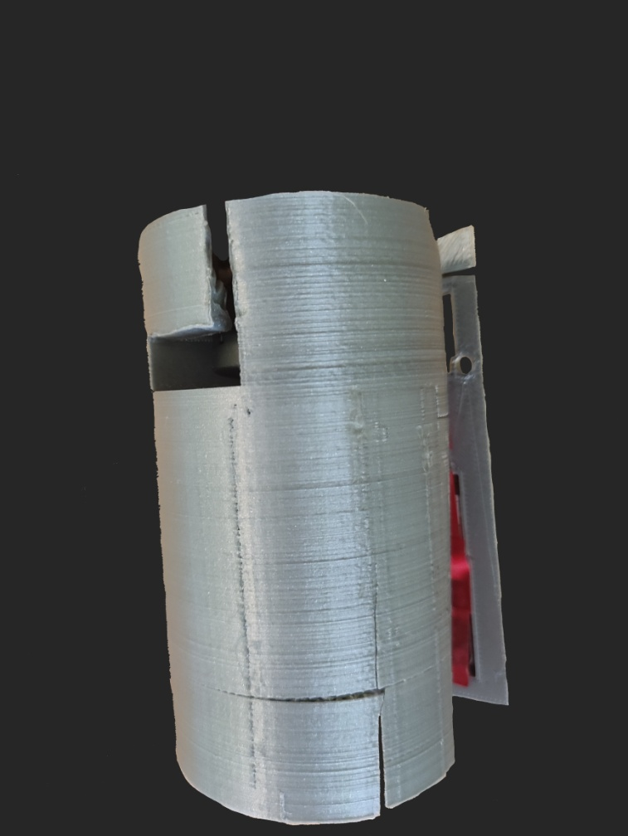
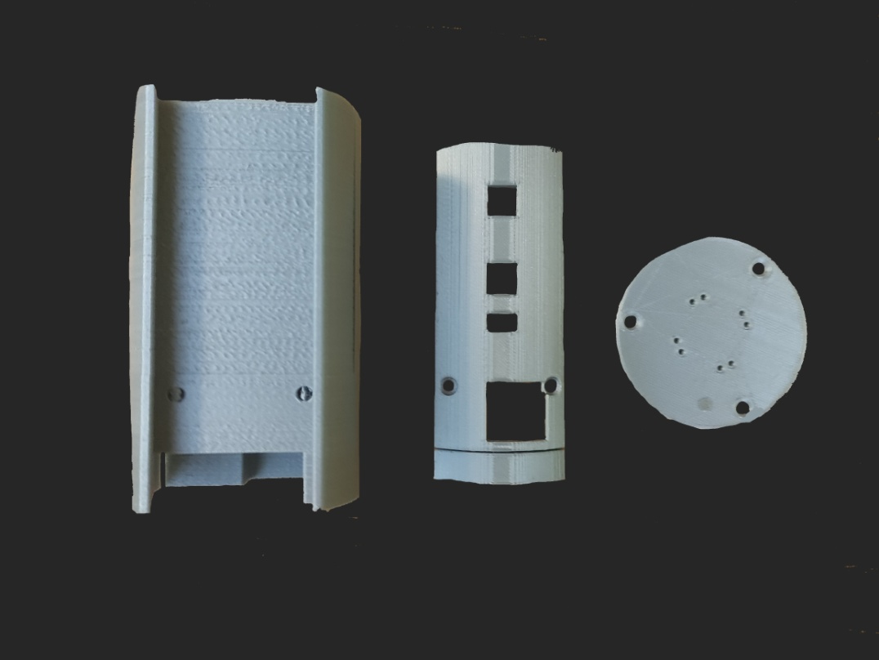
CanSat pictures
43 / 20
→ THE EUROPEAN SPACE AGENCY

Slide 44
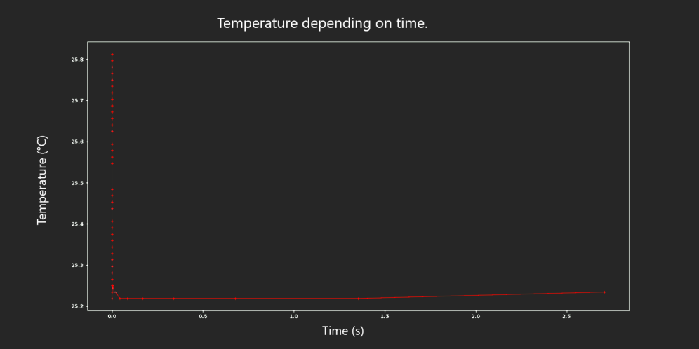
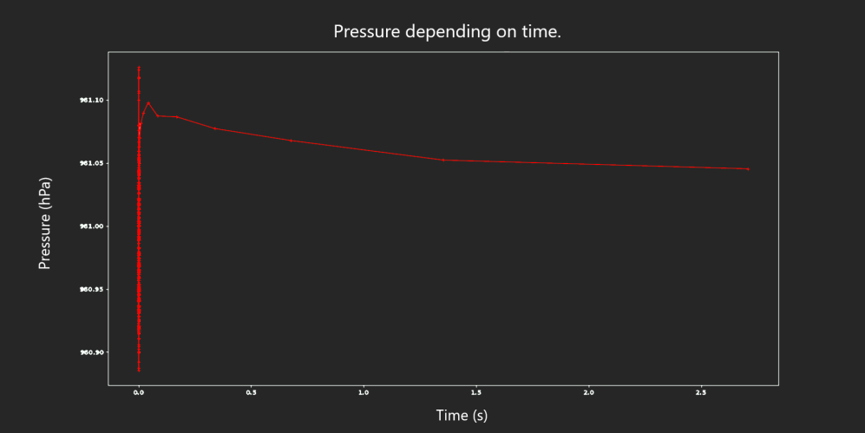
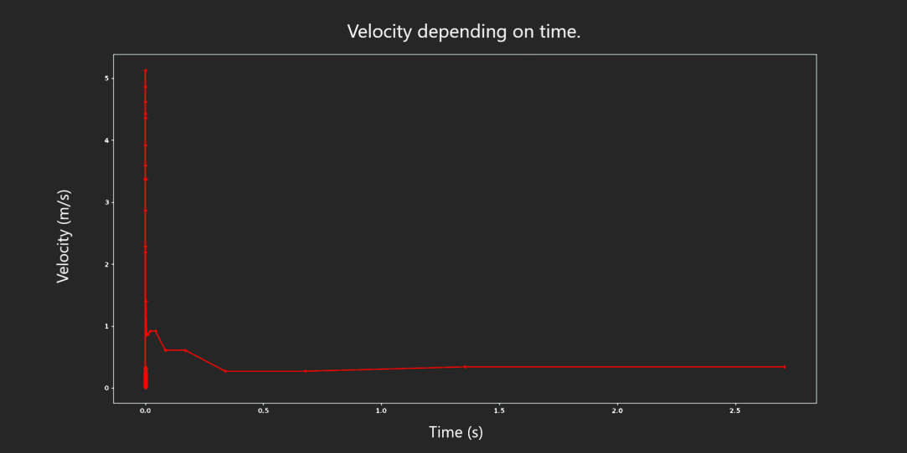
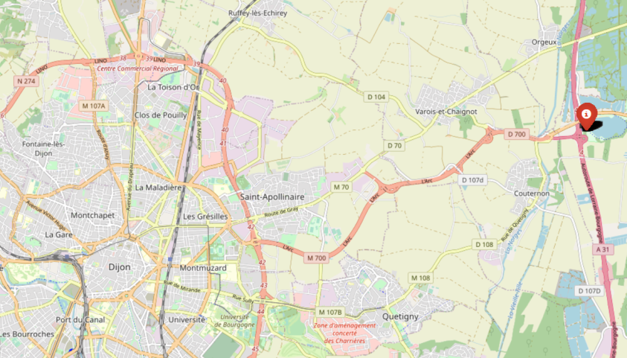
Recorded data
44 / 20
→ THE EUROPEAN SPACE AGENCY

