Slide 1

UYARI TEAM
PRELIMINARY DESIGN REPORT

Slide 2
Contents
  Quick Overview
  Technical Presentation
  Missions
  Budgets
  Emissions

Slide 3
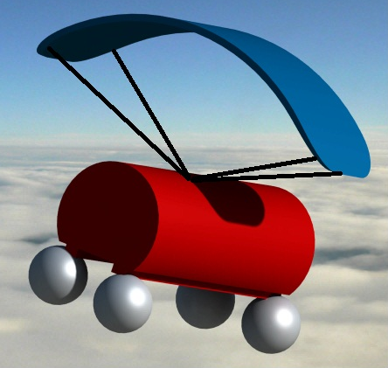
  Quick Overview
Open Class
  Diameter 80 mm
  Height 200mm
  Mass < 1Kg
  Volume < 1lt
Parachute
Missions:
  Atmospheric Sounding
  Deploying of RF Antenna
  Taking Photo
  Airbag
  Terraforming
Mechanic
Electronic
Airbag

Slide 4
Landing System
  We will use autonomous structure in our landing system
  Our system aimed at stroke to ten-meter diameter of landing point will be controlled by the servo, using software
  The parachute system is designed to leave the satellite when the satellite neared the ground
Parachute
  Parachute’s area is 48 cm²
  Designed to free parachute-type has seven cells

Slide 5
Mechanic
  One servo to control parachute
  One servo to seperate parachute system
  Airbag
  Terraforming Equipments
  RF Antenna Deploying Mechanism

Slide 6
Electronic
  Microcontroller
  GPS Module
  RF Module, Antenna
  Camera Module (Separate unit from RF Module)
  Humidity Sensor

Slide 7
Missions
  Atmospheric Sounding
    Degree of humidity
    Altitude value
  Deploying of a RF antenna after landing
Communication with ground station
  Photo
Taking enough quality photo
  Airbag
Airbags open when altitude is less than 4 meters
  Terraforming
Drilling a hole and leaving a crop

Slide 8
Costs
Components | Price
Battery | 19 £
Rf Antenne – module | 107 £
Photo – module | 98 £
Servo (2) | 7 £ (*2)
GPS | 48 £
Humdity Sensor | 24 £
Structure | 17 £
Terraforming | 7 £
Total | 334 £

Slide 9
Emissions:
RF Module is CC1110EMK433
Apparent radiating power (ARP) (dBW) calculation:
APR = 10*log10(Pe) + Ge - 2.14
Pe =1mW = 0.001 W
Ge= 1 (maximum)
APR = 10*log (10*0.001) + 1 - 2.14
APR = - 20 + 1 - 2.14
APR = - 21.14 dbW
10mW = -2 dbW
-21.14 dbW< -2dbW

